Slide 1

A new method for nuclei detection in 2-photon/confocal images
Antonin Perrot-Audet
5GE INSA Lyon,
TDSI, master GEGP SI
Notes:
Title for research

Slide 2
Outline
Context
State of the art
Proposal
Results/Evaluation
Conclusion
Notes:
Context what the melab studies, and how
State of the art nuclei detection : 3 representative articles
Proposal (quick overview of the method)
Result against 2 algo
Conclude about everything

Slide 3
Context

Slide 4
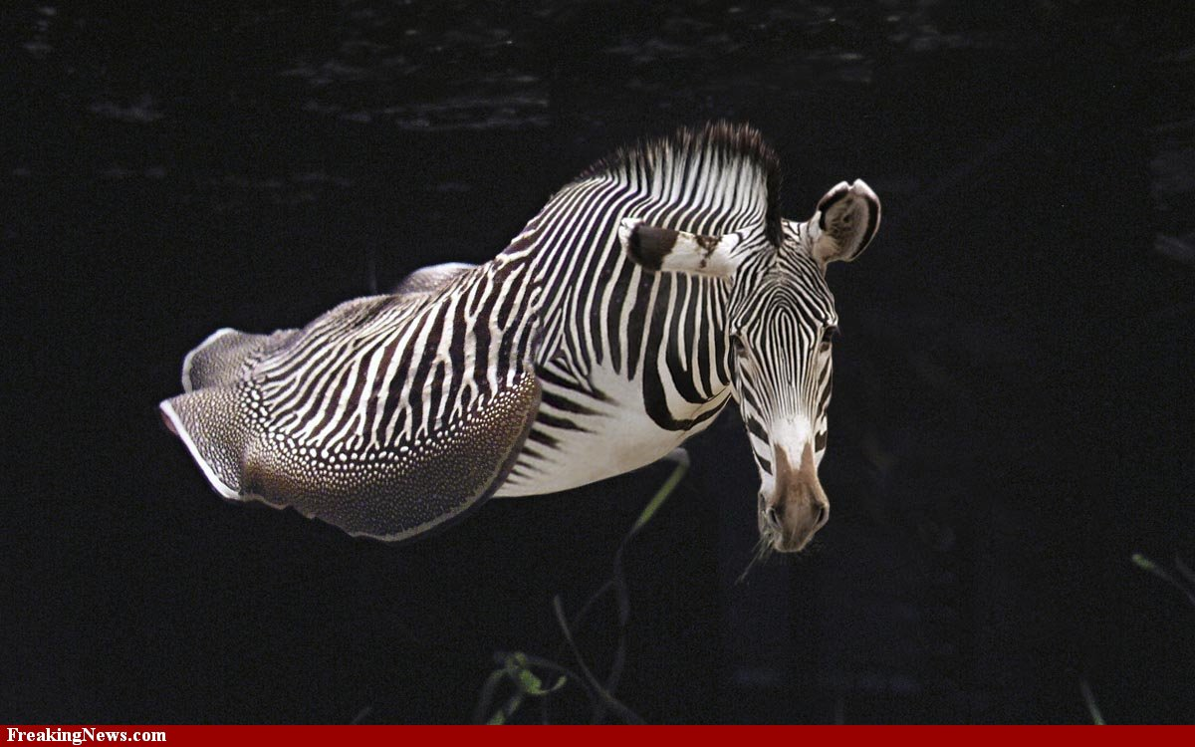
Context
The Megason lab studies the development of zebra fishes.
3cm
Notes:
Zebrafish… thanks to google

Slide 5
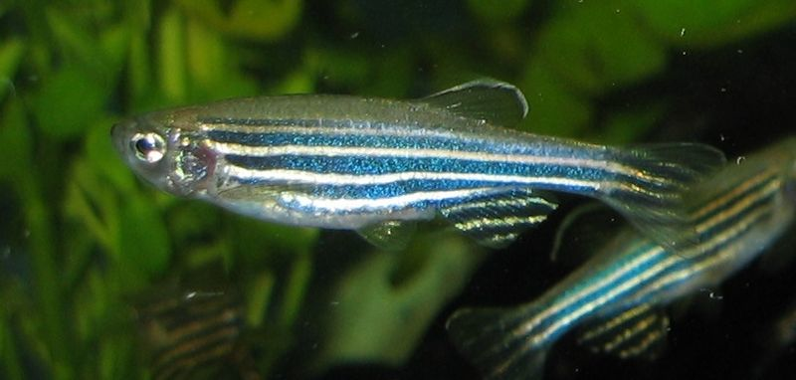
Context
The Megason lab studies the development of zebra fishes.
3cm
Zebrafish are used as a model system,
because their embryo is transparent.
Notes:
Zebrafish
Model system (transparent)

Slide 6
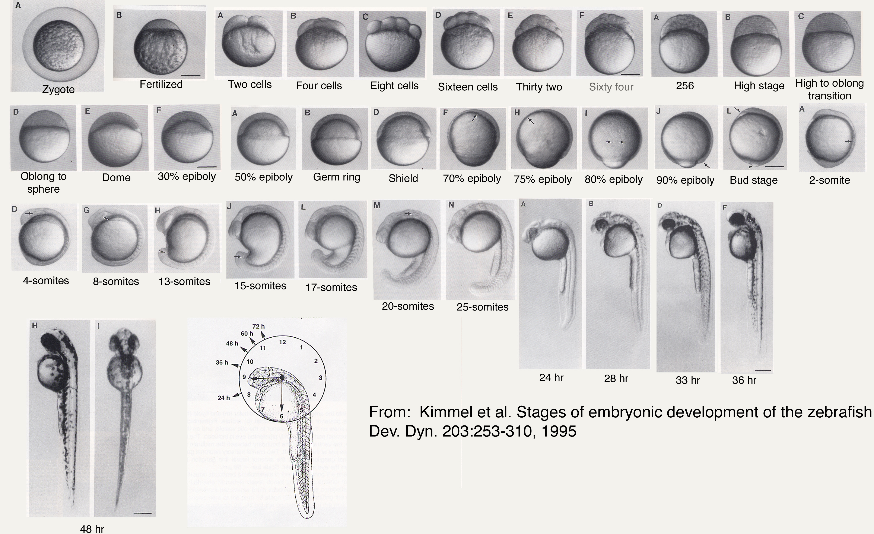
Development stages of a zebrafish embryo
Notes:
Zebrafish
Model system (transparent)

Slide 7
What strategies does an embryo use to make the right kind of cells?
p(X)
Cell Lineage
Cell Position
Chance,
Stochastic laws?
Notes:
Remove biology through observation
Questions instead
Sean pres on the Wiki for THAT.
Last sentence not connected to the last one
Developmental process
…. Take of those …. No ponctuation
Movie from someone whowing nuclear membrane protein expression.
In order to reach lt goal lineage analysis of various cell types
Expression analysis
Fondamental functionnal/structureunits : cells
Huge amount of cell
Find sth automatic to detect cells

Slide 8
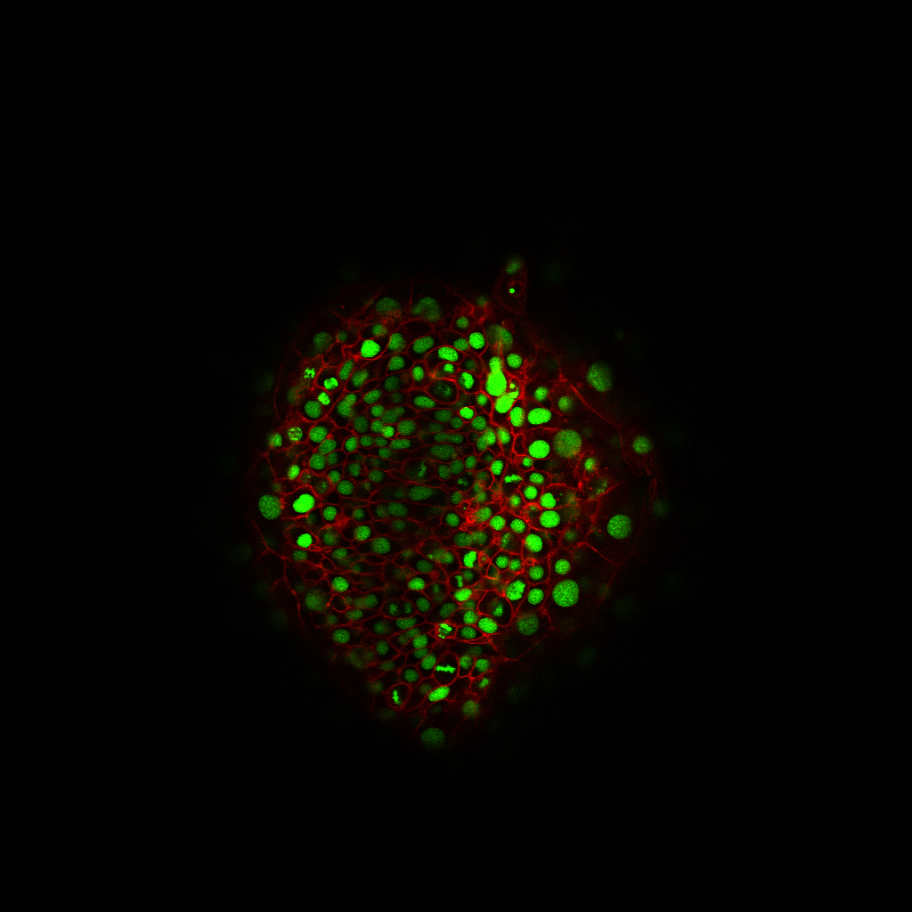
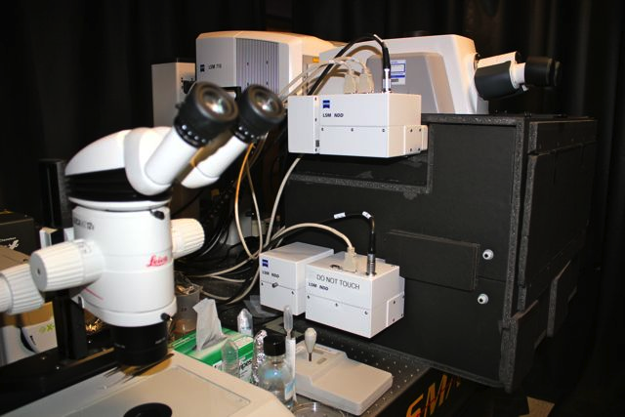
Imaging protocol
Living embryo
Numeric data
Notes:
Contrast !!!!
Mean message in each slide :
Imaging protocol
(arrow)

Slide 9
Context
the cell is the fundamental functional/structural element:
Huge amount of cell
Need for automated ways to detect, and segment, and track cells.
Notes:
Remove biology through observation
Questions instead
Sean pres on the Wiki for THAT.
Last sentence not connected to the last one
Developmental process
…. Take of those …. No ponctuation
Movie from someone whowing nuclear membrane protein expression.
In order to reach lt goal lineage analysis of various cell types
Expression analysis
Fondamental functionnal/structureunits : cells
Huge amount of cell
Find sth automatic to detect cells

Slide 10
Data challenges
Huge datasets :
1024x1024x70x700x2+ (X, Y, Z, T, Lambda)
Resolution : 0.2um in X and Y, 1um in Z, 2min in T
Hard to process :
Noisy
Anisotropic
Artifacts (interlacing, membrane closure missing…)

Slide 11
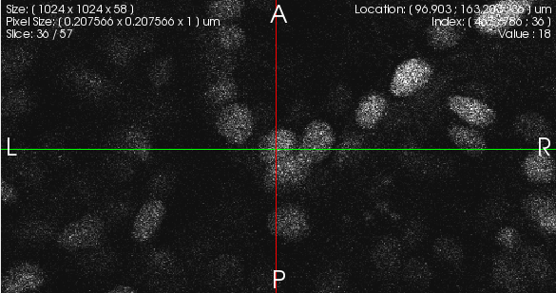
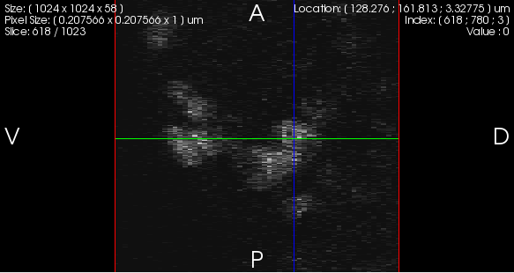
Data: noise & anisotropy
xy
xz
Notes:
Black background
Captions (xy, xz)

Slide 12
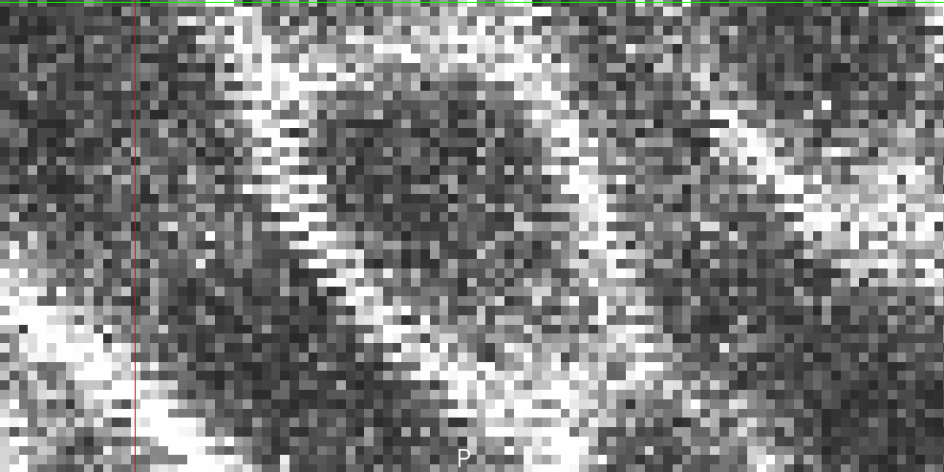
Data: interlacing artifact

Slide 13
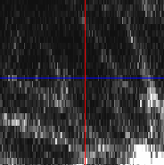
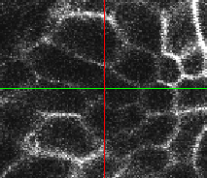
Data: intensity inhomgeneities
xy
yz
Notes:
Captions
Show three or crop

Slide 14
Goal: membrane segmentation
Notes:
Challenges/ goals
Check french spacing
No column in the end
Useful instead of capital
Ultimate goal is membrane segmentation BUT need nuclei detection
Membrane seg is the goal
-challenge
-solution

Slide 15
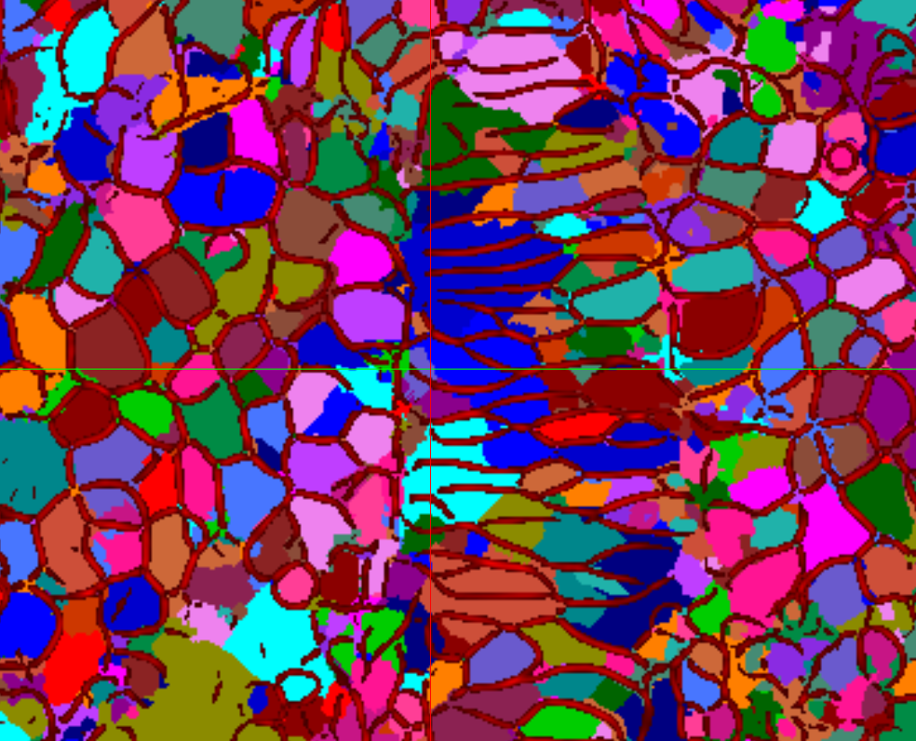
Goal: membrane segmentation
With the raw data
Notes:
Challenges/ goals
Check french spacing
No column in the end
Useful instead of capital
Ultimate goal is membrane segmentation BUT need nuclei detection
Membrane seg is the goal
-challenge
-solution

Slide 16
Goal: membrane segmentation
Problem
Data is incomplete
Segmentation needs a priori
Solution
Nuclei position provides information about membrane topology.
=> We need a good NUCLEI DETECTION
Notes:
Challenges/ goals
Check french spacing
No column in the end
Useful instead of capital
Ultimate goal is membrane segmentation BUT need nuclei detection
Membrane seg is the goal
-challenge
-solution

Slide 17
State of the art

Slide 18
Existing algorithms
In the literature :
G. Li et al. [1]
3D confocal dataset
Use an elastic gradient vector flow
P.S. Umesh Adiga et al. [2]
3D confocal histopathological images
Use mathematical morphology + distance map maxima
Yousef Al-Kofahi et al. [3]
2D histopathological images
Use scale constrained Multiscale Laplacien of Gaussien maximas
Notes:
More tile :
More

Slide 19
Existing algorithms
In the Megason lab:
Combination of several information (radial voting map[4] , Hough transform voting map, distance map)
Notes:
More tile :
More

Slide 20
Existing algorithms
In the literature:
Gradient based
Different data (2D, different imaging techniques)
In the Megason lab:
Performances need to be improved
Notes:
More tile :
More

Slide 21
Proposal

Slide 22
Proposal
Observations:
Most algorithms make use of the nuclei channel
The membrane channel also provides information about the nuclei position.
We propose to use information from both membrane and nuclear channel.
Assumptions:
Cell membrane is closed;
One closed cell contains a nucleus.
Membrane can be approximated by a Voronoi diagram centered in the nuclei.
Notes:
In general !!!!

Slide 23
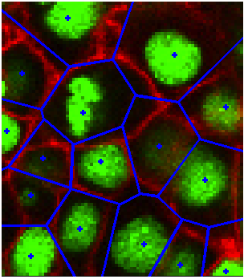
Voronoi cell captures the cell membrane
Sites
Regions
Boundaries
Notes:
Make arrows

Slide 24
Procedure
Method :
How :
Notes:
Flowchart

Slide 25

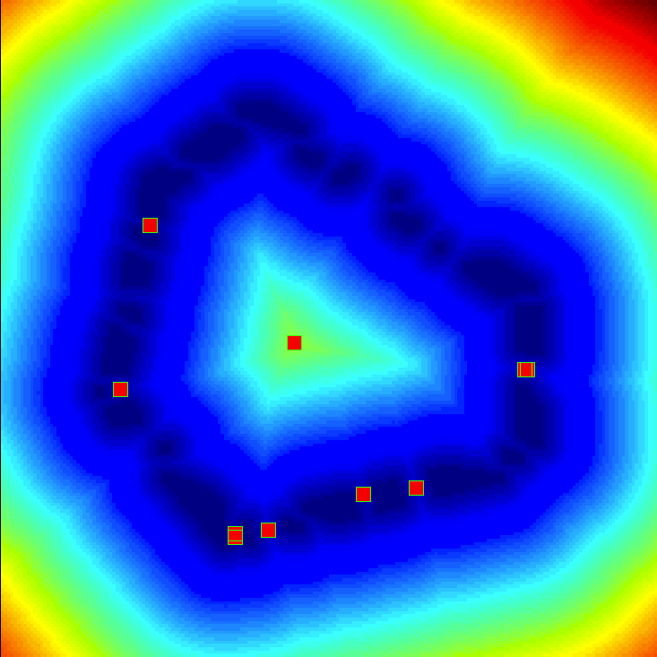
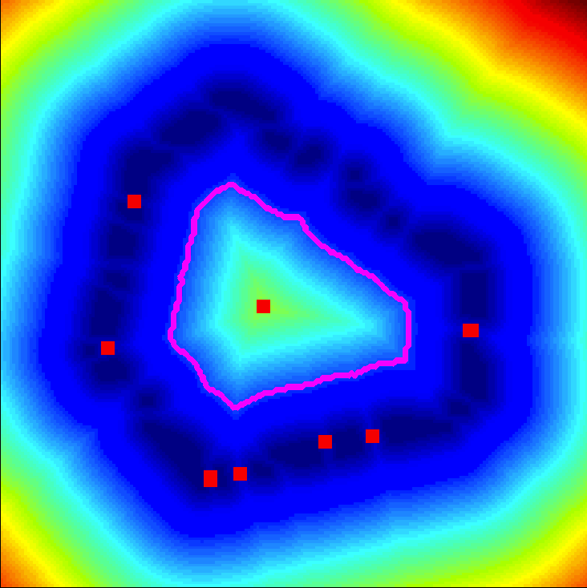
Detection of approximate Voronoi regions: threshold on the distance map

Slide 26
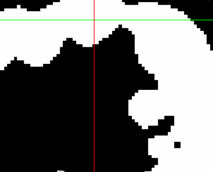
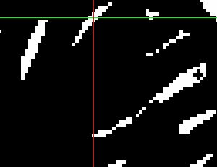
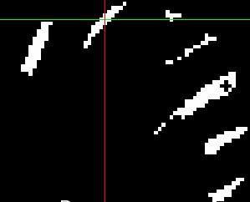
Masking Voronoi regions with nuclei binary image
Use of the nuclei channel :
Adjust the localization of centroids :
Use this information to mask the approximate Voronoi regions, and center the regions on the nuclei.

Slide 27
Algorithm Summary
Membrane information : for finding Voronoi regions in which one nuclei is present.
Nuclei information : for centering the estimation of the nuclei position.

Slide 28
Evaluation

Slide 29
Evaluation
Evaluation/Comparison of several algorithms:
Scale constrained multiscale Laplacian of Gaussian [3] (MLOG)
Existing algorithm in the Megason lab (KA)
Our proposal (P)
“Success” measure :

Slide 30
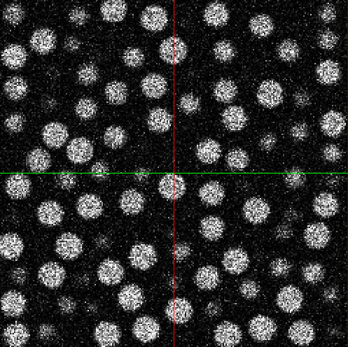
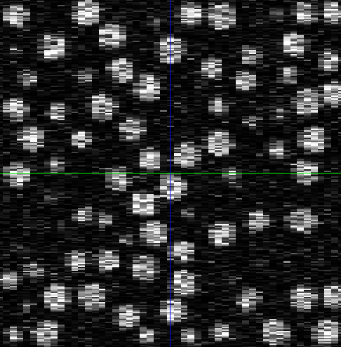
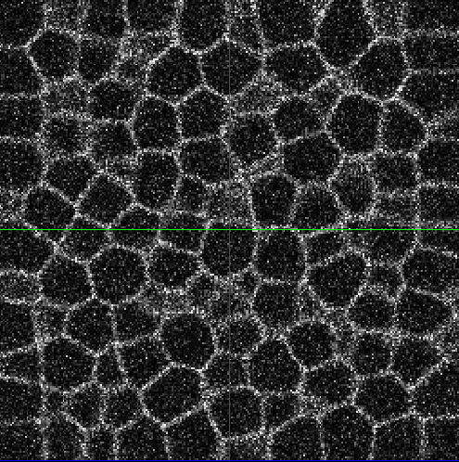
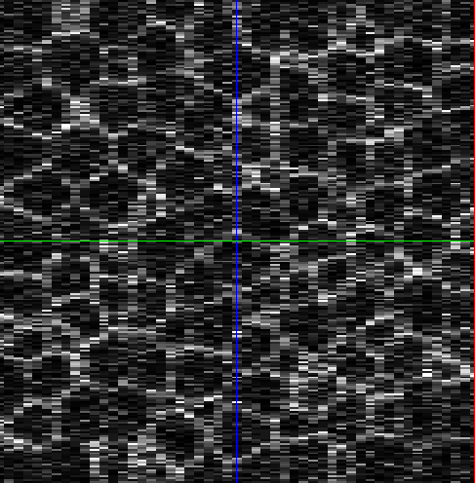
Evaluation on synthetic dataset
Notes:
Evaluation datasets :
Synthetic:
10 datasets containing 100 to 1000 Nuclei
Simulates :
Noise,
Point spread function & anisotropy.
Does not include:
Intensity inhomogeneity & lack of information,
Overlapping nuclei.

Slide 31
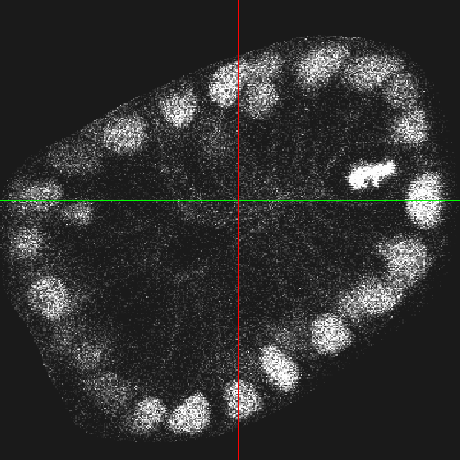
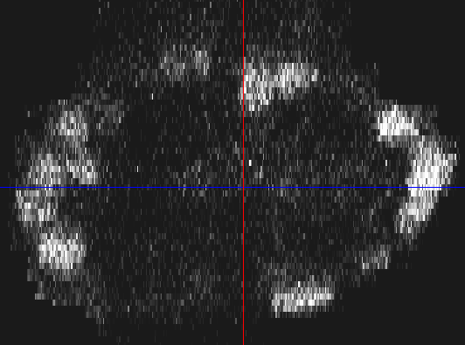
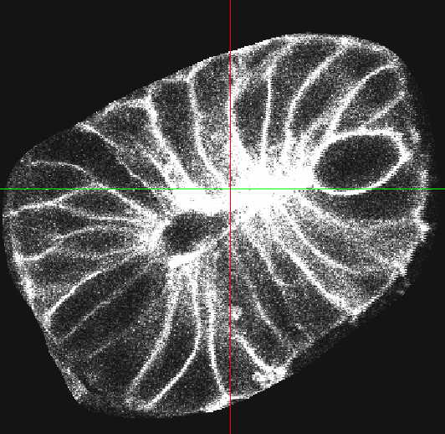
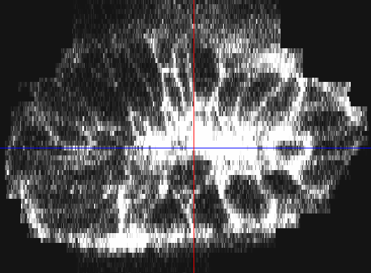
evaluation on real dataset
Notes:
Real:
A region containing 141 nuclei was manually segmented

Slide 32
Results
On the hardest synthetic data (1000 nuclei):
On real data (141 nuclei) :
Algorithm | Results
 | correct | outside | over-detected | success(%)
MLOG | 1000 | 72 | 0 | 93.3
KA | 182 | 1539 | 0 | 7.2
P | 964 | 11 | 0 | 95.4
Algorithm | Results
 | correct | outside | Over-detected | success(%)
MLOG | 104 | 52 | 8 | 51.7
KA | 71 | 56 | 37 | 30.3
P | 85 | 30 | 3 | 48.9
Notes:
Delete column with same data

Slide 33
Conclusion
Proposal:
We proposed a new algorithm, taking advantage of both channels.
We showed that this algorithm performs better than the existing algorithm on synthetic and real data:
Significantly more robust
Less false positives
Compares to state of the art algorithm

Slide 34
Future directions
There are several ways to improve our algorithm.
Automatic thresholds.
Context dependant fusion with other algorithms.
Use the detection of cell nuclei for membrane segmentation.

Slide 35
Acknowledgments
Sean MEGASON
Kishore MOSALIGANTI
Arnaud GELAS
Olivier BERNARD
Rémy PROST
Matthiew MACCORMICK
Isabelle BLOCH
Nicolas RANNOU
Lydie SOUHAIT
Amelia GREEN
Nikolaus OBHOLZER
Ramil NOCHE
Raghav K. PADMANABHAN
Luis IBANEZ

Slide 36
References
[1] G. Li, T. Liu, A. Tarokh, J. Nie, L. Guo, A. Mara, S. Holley, and S.T.C. Wong. 3D cell nuclei segmentation based on gradient flow tracking. BMC cell biology, 8(1):40, 2007.
[2] P.S. Umesh Adiga and BB Chaudhuri. An efficient method based on wa- tershed and rule-based merging for segmentation of 3-D histo-pathological images. Pattern Recognition, 34(7):1449–1458, 2001.
[3] Y. Al-Kofahi, W. Lassoued, W. Lee, and B. Roysam. Improved Automatic Detection & Segmentation of Cell Nuclei in Histopathology Images. IEEE transactions on bio-medical engineering, 2009.
[4] H. Chang, Q. Yang, and B. Parvin. Segmentation of heterogeneous blob objects through voting and level set formulation. Pattern recognition letters, 28(13):1781–1787, 2007.
Notes:
More tile :
More

Slide 37
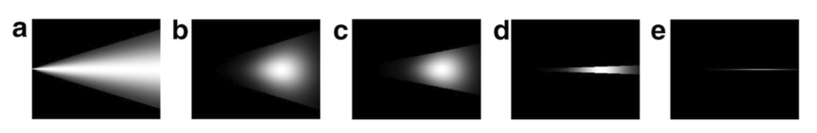
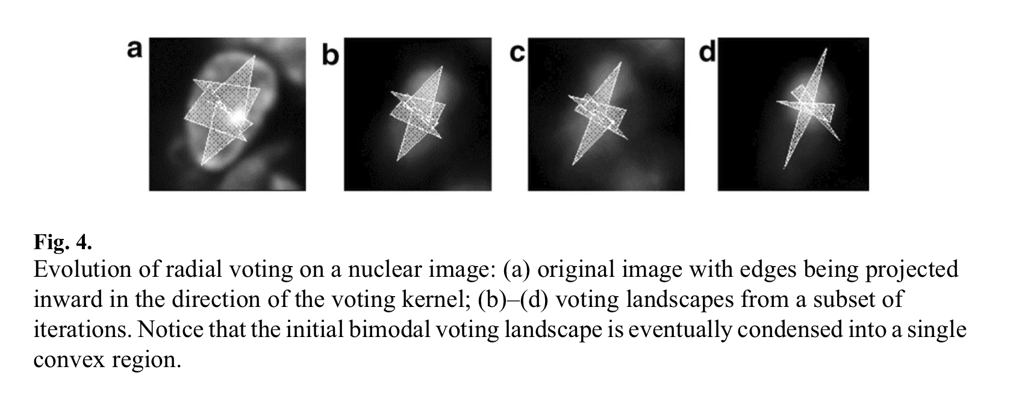
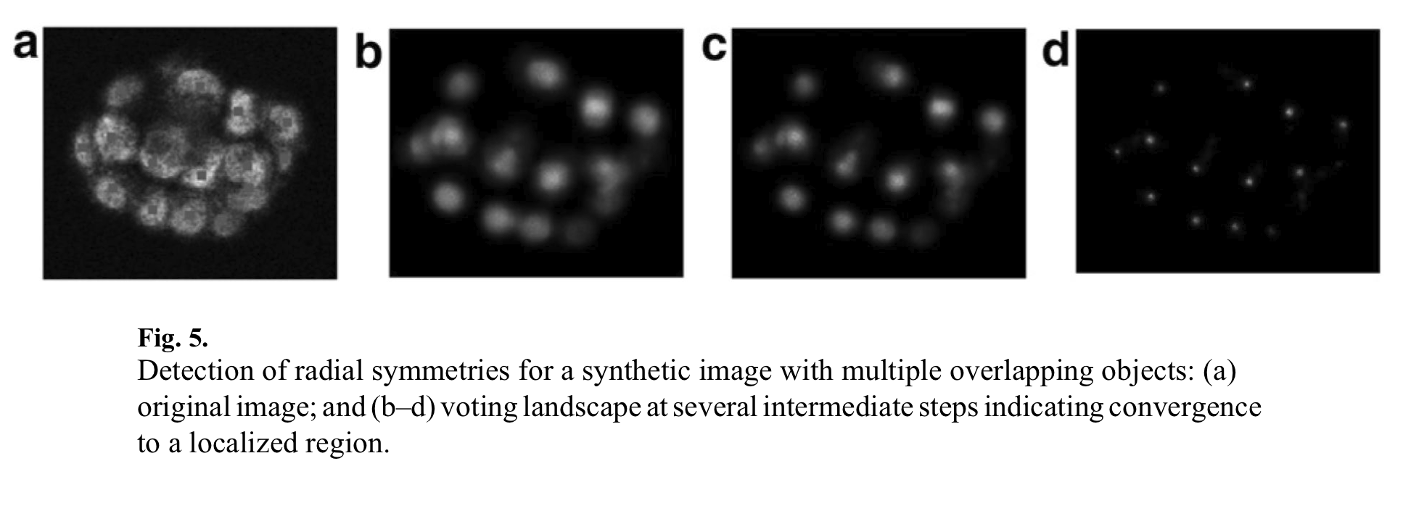
Radial Voting
Evolution of radial voting kernel.
Evolution of radial voting on a nuclei image.
Initial voting is condensed into a single convex voting region.

Slide 38
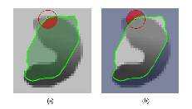
Use of nuclei information for membrane detection

Slide 39
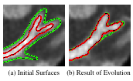
Use of nuclei information for membrane detection

Slide 40
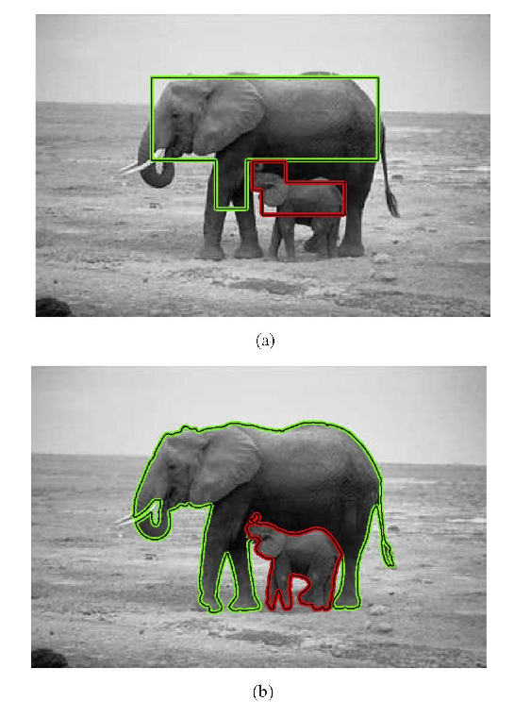
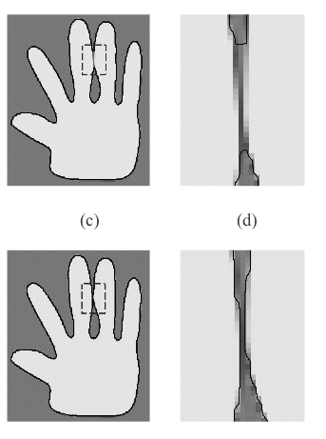
Use of nuclei information for membrane detection
OR

Slide 41
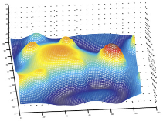
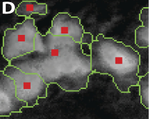
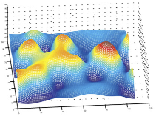
Scale constrained Multiscale Laplacian of Gaussian

Slide 42
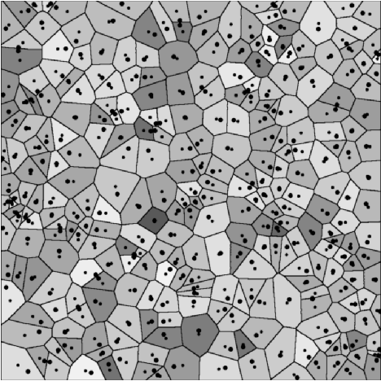
Radial Voting

